Slide 1


Price Analysis of Washing Machine using FlipKart
Presented by :
Vasist
Ravi kumar

Slide 2

PRICE ANALYSIS OF WASHING MACHINES

Slide 3

Web Scraping – Details:
Website: Flipkart
Problem Statement:
Analysis on prices of the Washing Machines available in Flipkart

Slide 4

Objective of the Project:
The objective of this project is to perform a descriptive analysis and Visualization of the prices of washing machines available in Flipkart and is to understand the factors that influence pricing.
It is done by analyzing various factors that are influencing washing machine prices. These factors include Brand, Speed, Capacity, Automation Type and Load Type.
This project aims to provide insights that can inform consumers, retailers, and manufacturers in their decision-making processes.

Slide 5




Required Libraries:
requests
BeautifulSoup
Regex(re)
Pandas
Numpy
matplotlib.pyplot
seaborn

Slide 6
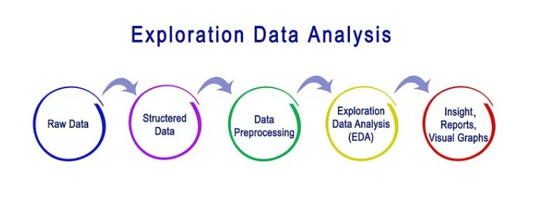
Steps Involved in EDA:
Business Understanding/Problem Statement
Data Collection/Data Mining
Data Cleaning
Data Analysis
Data Visualization

Slide 7
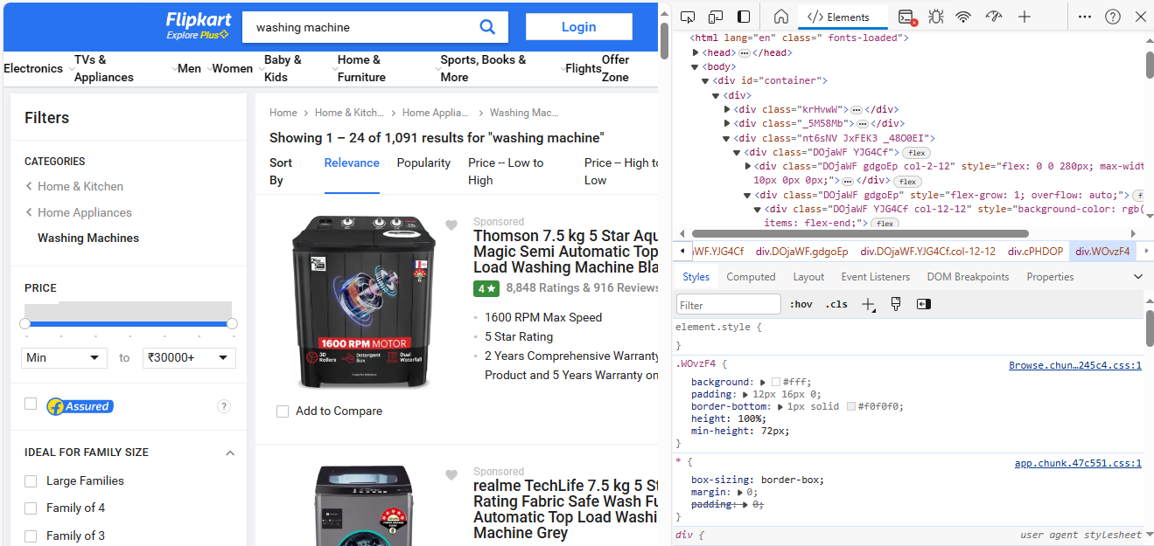
DATA FROM FLIPKART WEBSITE:
Here data is taken from Flipkart website using HTML

Slide 8


Slide 9
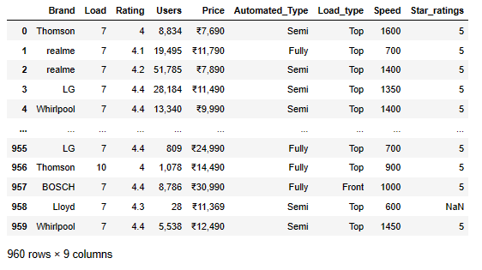
Data Collection:
Here data is collected from the website and structured it to a DataFrame

Slide 10
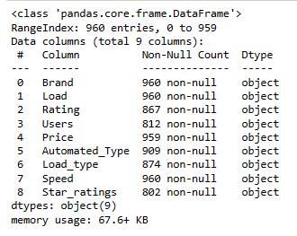
Raw data:
In the raw data the data types of all the columns is object and type casting will be done in Data Cleaning

Slide 11


Slide 12
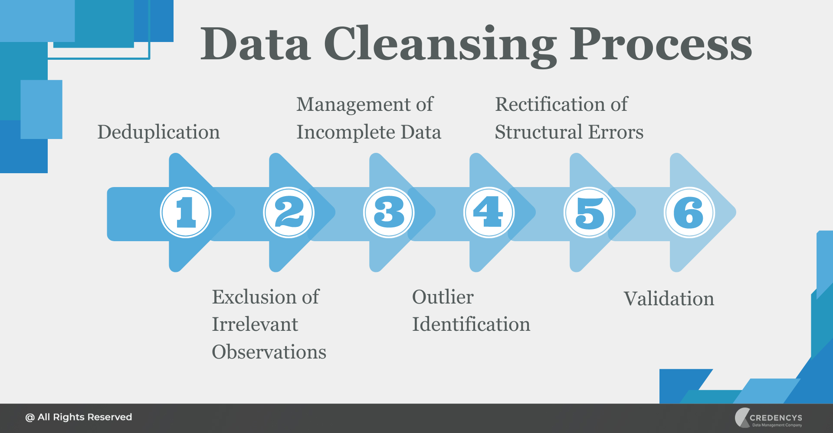
Data Cleaning:
Handle Missing Values
Remove Duplicate Entries
Correct Data Types
Handle Outliers

Slide 13
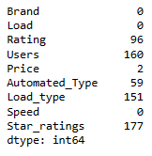
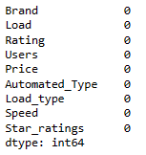
Missing Value Treatment:
Missing Values before Missing Value Treatment
Missing Values before Missing Value Treatment

Slide 14
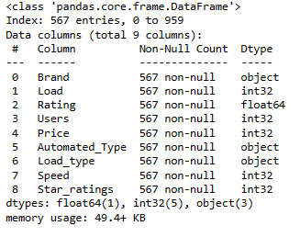
Type Casting:
Data Types of columns after converting it to correct Data Types

Slide 15
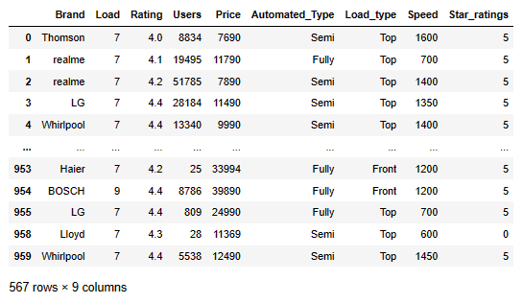
Structured Data After Data Cleaning:
This is the complete structured data after treating missing values, removing duplicates, type casting and handling outliers

Slide 16
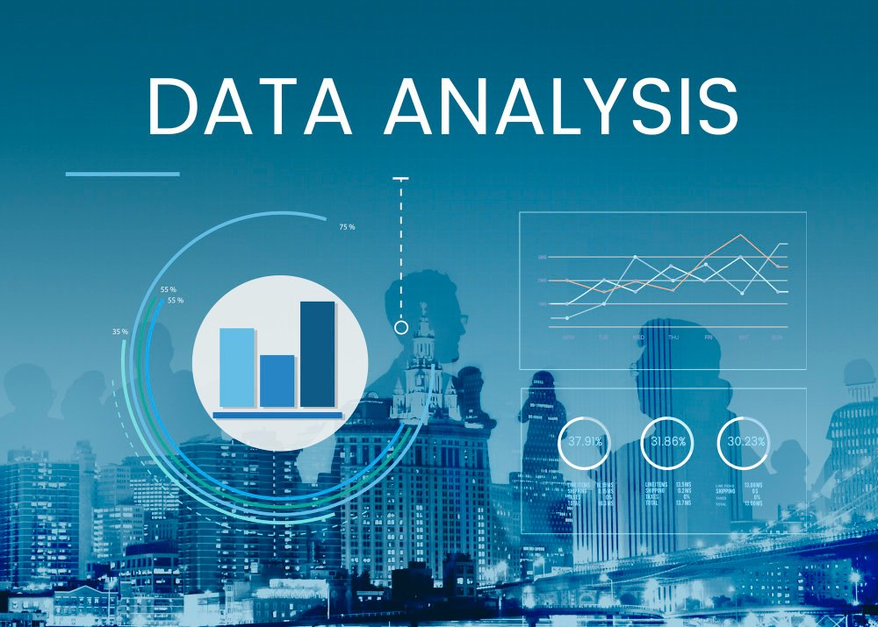

Slide 17
Data Analysis:
In order to understand the basic patterns, relationships, and distributions of data, a variety of methods and techniques are included into the field of exploratory data analysis, or EDA. Some types of exploratory data analysis methods include the following:
Univariate Analysis: This analysis focuses on analyzing individual variables in data. It includes techniques such as histograms, density plots, box plots, and bar charts to visualize the distribution of a single variable.
Bivariate Analysis: This analysis examines the relationship between two variables. Scatter plots, line plots, and Arae plots are commonly used techniques to visualize the association between two variables.
Multivariate Analysis : This analysis explores relationships between three or more variables simultaneously. Techniques such as heatmaps and pair plots visualize interactions and correlations between multiple variables.

Slide 18
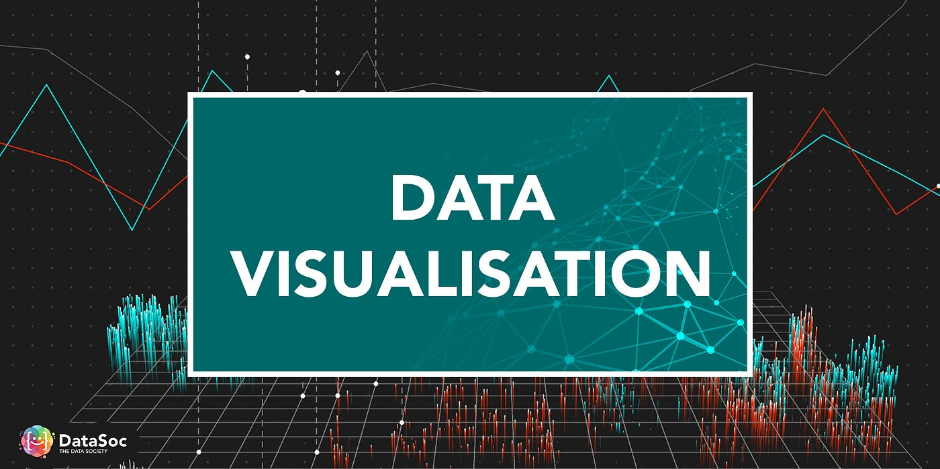

Slide 19
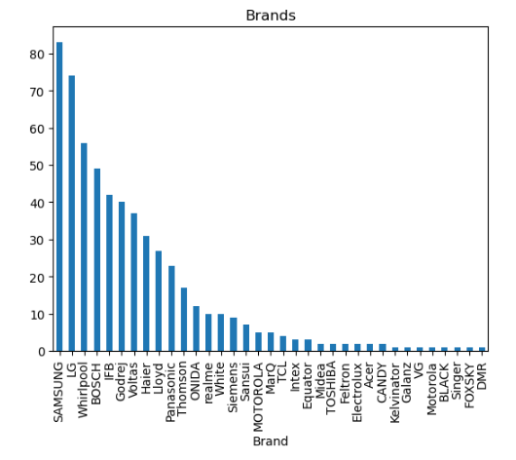
Univariate Analysis:
Barplot
Description:
Here Barplot is used to represent the count of Brands that are available in Flipkart website.
From the plot we can observe that Samsung brand is the highest available brand.
Through this insight consumers will be able to know the availability of brands in Flipkart.

Slide 20
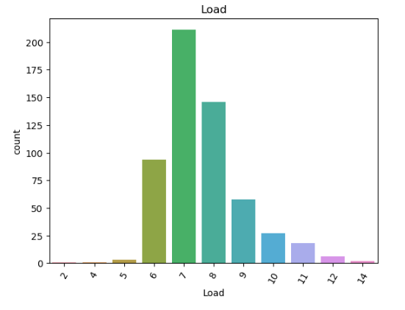
Countplot
Description:
Here Countplot is used to represent the washing machines with different loads/Capacities
From the countplot we observe that the washing machines with 7kg load is the mostly available followed by 8kg and 9kg where as 2kg, 4kg are the least available

Slide 21
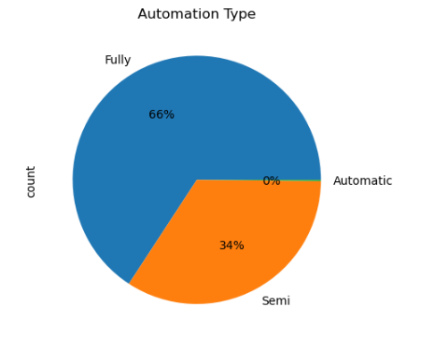
Piechart:
Description:
Here Piechart is used to represent the Automation types of Washing Machines.
From the piechart there are twoTypes in washing machines.
1) Fully Automated
- 66%
2) Semi Automated
- 34%
Here fully automated washing machines are more in number than semi automated washing machines

Slide 22
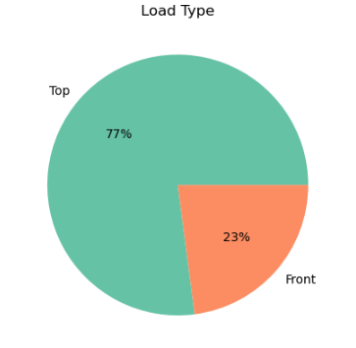
Piechart:
Description:
Here Piechart is used to represent the Load types of Washing Machines.
From the piechart there are two Types in washing machines.
1) Top Load
- 77%
2) Front Load
-23%
Here Top load washing machines are more in number than Front load washing machines

Slide 23
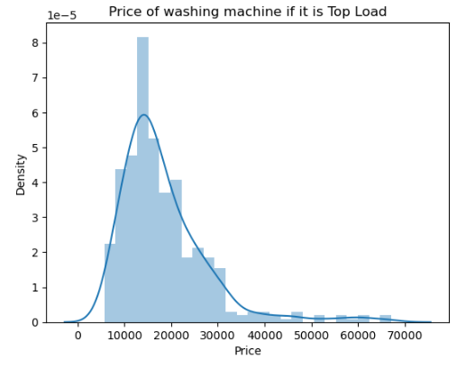
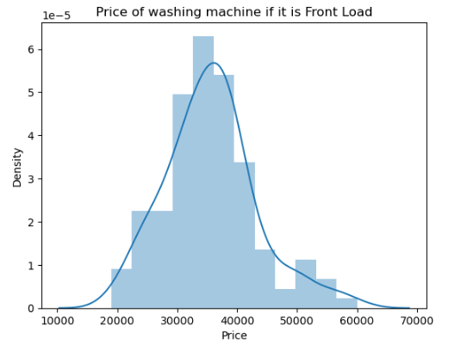
Comparision of Prices with respect to the Load Type Density plot Description: Price is compared and we can observe that the Front Load washing machines are costlier than Top Load washing machines.

Slide 24
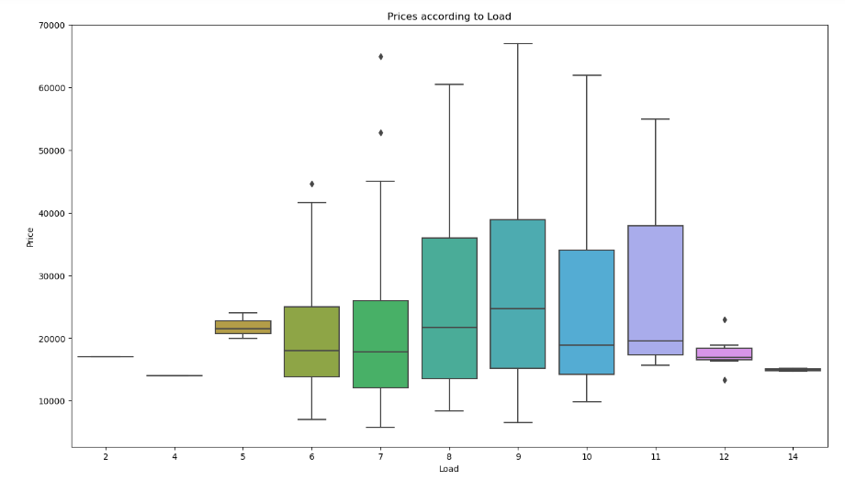
BoxPlot:
Boxplots are useful for identifying outliers, comparing distributions, and understanding the spread.
Here Boxplot is used to understand the distribution of Prices with respect to load.

Slide 25
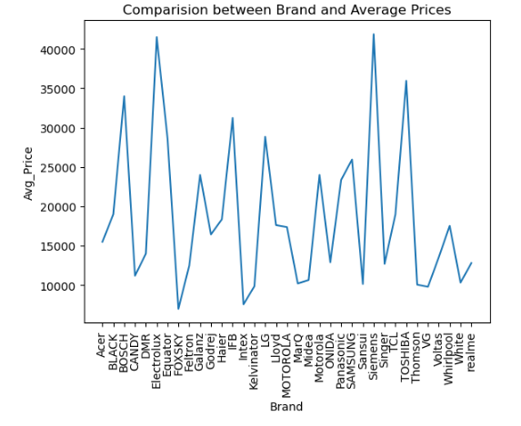
Bivariate Analysis:
Line plot:
A line plot, also known as a line graph, that displays data points connected by straight line segments. It is commonly used to visualize trends over time or to show the relationship between two variables.
Here Average price of each brand is represented.
From the data Electrolux and Siemens have highest average price

Slide 26
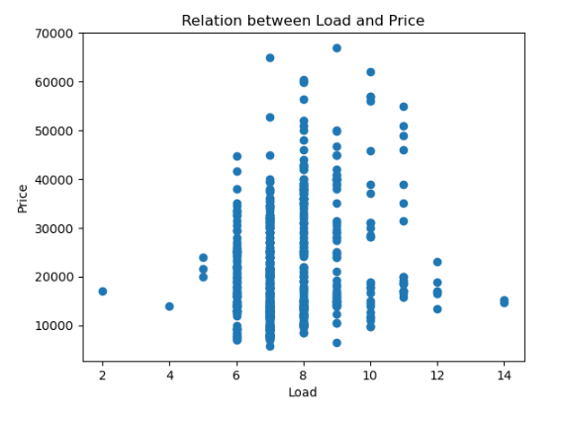
Scatter Plot:-
A scatter plot displays values of two continuous variables as points on a two-dimensional plane.
Each point on the plot represents the value of one variable against the value of another variable. Scatter plots are commonly used to examine the relationship between two variable.
The below Scatter plot displays the variation of price according to load.

Slide 27
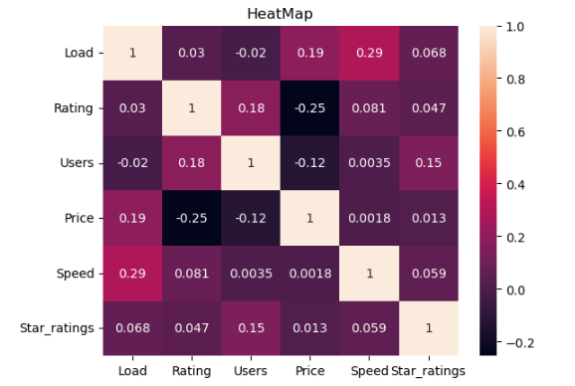
Multivariate Analysis:
HeatMap :-
Here we are using heatmap to represent the correlation between each column in the dataset.
multivariate heatmaps are a powerful visualization technique for gaining insights into complex relationships and patterns across multiple variables in multivariate datasets.
A heatmap contains values representing various shades of the same colour for each value to be plotted. Usually the darker shades of the chart represent higher values than the lighter shade.

Slide 28
CONCLUSION :
Prices of the Washing Machines is analyzed using Data Analysis and Visualization
Variations in the prices are compared by taking different brands and features of Washing Machines.
From the analysis and visualization we can conclude that the price of the Washing Machine varies according to its Features and Brands.
The price of Washing Machine with Fully Automated and Front load has higher price than the Washing Machine with Semi Automated and Top Load.
Through this insights it will be easy in the process of decision making for Consumers as we also included the Ratings and Reviews of the products.

Slide 29

THANK
YOU

